Slide 1
DV Routing Project Walkthrough
CS 6250

Slide 2
Distance Vector Routing
The lectures discussed Distance Vector (DV) routing protocols, one of the two classes of routing protocols
DV protocols, such as RIP, use a fully distributed algorithm that finds shortest paths by solving the Bellman-Ford equation at each node
In this project, you will implement a distributed Bellman-Ford algorithm and use it to calculate routing paths in a network
This is similar to the STP project, except we are solving a routing problem, not a switching problem
Kurose and Ross: “Where LS algorithms use global information, the DV algorithm is iterative, asynchronous, and distributed.”
Nodes will NOT have a complete map of the network

Slide 3
Distance Vector Routing
“Pure” DV routing protocols use hop count (aka number of links to be traversed) to determine distance between nodes.
Some DV routing protocols at higher levels (such as BGP for interdomain routing) must make routing decisions based on business relationships as well as hop count.
These protocols are sometimes called Path Vector protocols.
This project will explore these routing decisions and challenges by using weighted links (including negatively weighted links) in our network topologies.
Each node represents an individual Autonomous System (AS), and the weight of the link represents business relationships between ASes.
Links are directed – originating at one Node and terminating at the other

Slide 4
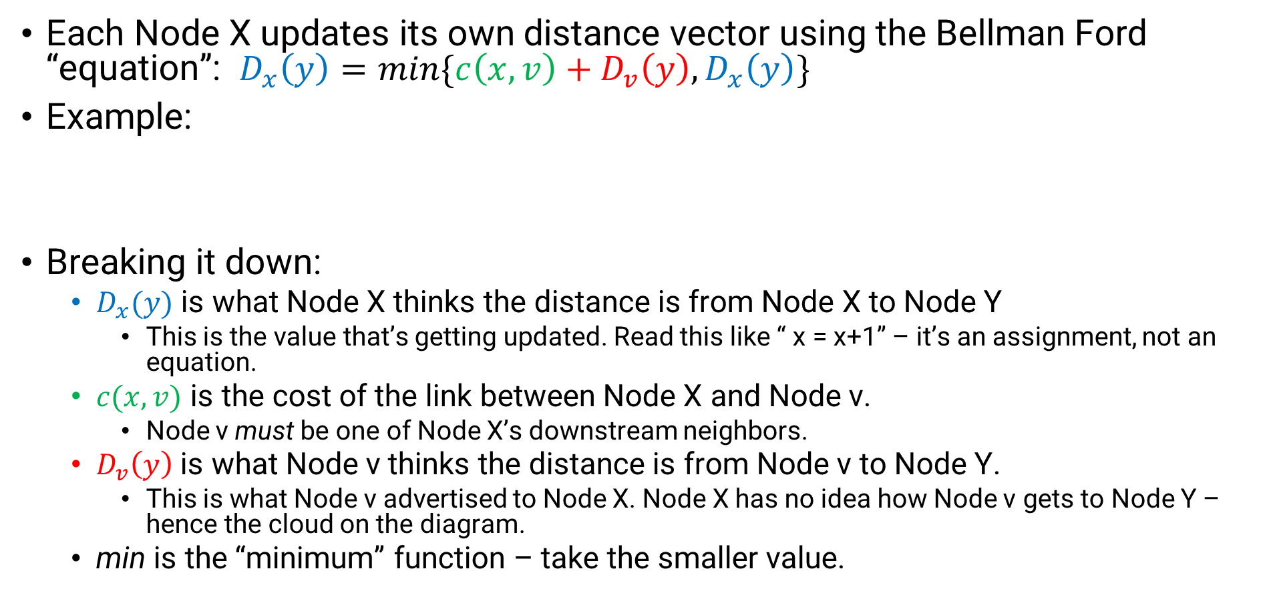
Bellman-Ford Algorithm
Each Node X updates its own distance vector using the Bellman Ford “equation”: $D_{x}\left(y\right)=\min{\{c\left(x, v\right)+D_{v}\left(y\right), D_{x}\left(y\right)\}}$
Example:
Breaking it down:
$D_{x}(y)$ is what Node X thinks the distance is from Node X to Node Y
This is the value that’s getting updated. Read this like “ x = x+1” – it’s an assignment, not an equation.
$c(x,v)$ is the cost of the link between Node X and Node v.
Node v must be one of Node X’s downstream neighbors.
$D_{v}\left(y\right)$ is what Node v thinks the distance is from Node v to Node Y.
This is what Node v advertised to Node X. Node X has no idea how Node v gets to Node Y – hence the cloud on the diagram.
min is the “minimum” function – take the smaller value.
X
v
Y

Slide 5
Resources
Some helpful resources to learn more about the Bellman-Ford algorithm:
Wikipedia
Kurose and Ross textbook
And of course, we expect that you watched/read the course lectures relating to the topic. ☺

Slide 6
Project Files
DistanceVector.py - This is the only file you will modify. It is a specialization (subclass) of the Node class that represents a network node (i.e., router) running the Distance Vector algorithm, which you will implement.
Node.py - Represents a network node, i.e., a router.
Topology.py - Represents a network topology. It's a container class for a collection of DistanceVector Nodes and the network links between them.
run_topo.py - A simple “driver” that loads a topology file (see *Topo.txt below), uses that data to create a Topology object containing the network Nodes, and starts the simulation.
helpers.py - This contains logging functions that implement that majority of the logging code for you.
*Topo.txt - These are valid topology files that you will pass as input to the run.sh scrip.

Slide 7
Project Files (continued)
BadTopo.txt - This is an invalid topology file, provided as an example of what not to do, and so you can see what the program says if you pass it a bad topology.
output_validator.py - This script can be run on the log output from the simulation to verify that the output file is formatted correctly. It does not verify that the contents are correct, only the format.
run.sh - Helper script that launches the simulation on a specified topology and automatically runs the output validator on the log output when the simulation finishes; basically a convenient wrapper for run_topo.py and output_validator.py .

Slide 8
TODOs in DistanceVector.py
Design and implement a data structure for each node to use to keep track of its distance vector (path weights).
This should be local to the node, defined in the init function, accessible via the self object (ex: “self.mylist”)
This does not need to be complicated – simple is probably best.
You’ll also have to design and implement what will constitute a message for your implementation
Implement the Bellman-Ford algorithm
Each node will need to a) send out initial messages to its neighbors, b) process messages received from other nodes, and c) send updates as needed.
Initially, a node only knows of a) itself and that it is reachable at cost 0, and b) its neighbors and the weights on its links to its neighbors
Take a look at Node.py for more info on how each Node will know this information

Slide 9
TODOs in DistanceVector.py
Write a logging function that is specific to your particular data structures.
You can use the logging helper files to take care of the bulk of the logging.
Logging should happen at the Node level; do NOT access the topology for logging.

Slide 10
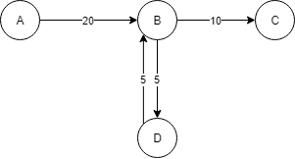
Clarifications and assumptions: Node behavior
Links are unidirectional; they show how traffic flows, but messages can be passed in either direction.
Node B can send messages to Node A, even though the link direction goes the other way.
A Node’s distance vector is comprised of the nodes it can reach via its outgoing links (including itself at distance = 0; never <0)
Nodes do not implement poison reverse or split horizon.

Slide 11
Clarifications and assumptions: weights
Edge weight values may be between -50 and 50, inclusive.
There is no upper limit for path weights.
“path” is a series of connected edges.
Example: A->B->D has path weight 25.
The lower limit for path weights is “-99”, which is equivalent to negative infinity for this project.

Slide 12
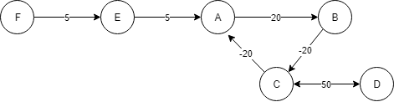
Negative Cycles
Negative weights can interfere with shortest path algorithms when there is a negative cycle
Example:
What’s the shortest path from E to D?

Slide 13
Negative Cycles
Negative weights can interfere with shortest path algorithms when there is a negative cycle
Example:
What’s the shortest path from E to D?
E->A->B->C->D is 5+20+(-20)+50 = 55
E->A->B->C->A->B->C->D = 5+20+(-20)+(-20)+20+(-20)+50 = 35
We have a negative count-to-infinity problem

Slide 14
Negative Cycles
“-99” represents negative infinity for our project.
Any node that can reach a destination node and infinitely traverse a negative cycles en route will set the distance to that node to -99.
Your implementation only needs to detect and record these traversals; it does not need to mitigate them.
Prof Vigoda talks about this, specifically with the Bellman-Ford algorithm, in one of the “Intro to Graduate Algorithms” videos on Udacity (linked in project description)
A Node can advertise a negative distance for other nodes (but not itself.)
A Node will not forward traffic destined to itself

Slide 15
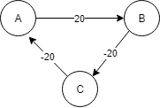
Negative Cycles
Example:
There is no “count-to-infinity” problem here.
A to C will follow A->B->C = 0, because C will not forward it back to A (C is the destination)
C to A will follow C->A = -20, because A will not forward traffic meant for A (A is the destination)
Note that negative paths do exist.
B should advertise to A that B has a path of -20 to C.
Notice that this example is a subgraph of the earlier Negative Cycle example.

Slide 16
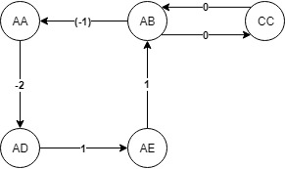
Example: Initialization
See P4_Example.xlsx for the following example.
Note that there are different iterations on different tabs

Slide 17
Example: Initialization
Msg format: | (origin node, origin node distance vector)
Messages are sent to incoming links/upstream neighbors only.
This is because a node only cares about other nodes it can reach
so it only wants messages from its outgoing nodes.
Node | Vector | Messages
AA | AA0 | AD, AD0
AB | AB0 | AA, AA0 | CC, CC0
AD | AD0 | AE, AE0
AE | AE0 | AB, AB0
CC | CC0 | AB, AB0

Slide 18
Example: 1st Iteration
Processing: Looping through the nodes in the distance vector
Add cost to the message origin to the weight for that node
Process all messages before going on to the next node (loop through the queue)
So AB will process the message from CC before moving onto AD
If messages cause a change, then the node will send messages to incoming links
Nodes will ignore distances to themselves
because they want traffic that arrives at themselves to stay there
 | Before Processing |  |  | Processing: cost to origin + NodeWeight | After Processing
Node | Vector | Messages: Origin, NodeWeight |  |  | New Vector | Messages
AA | AA0 | AD, AD0 |  | AD:-2+0=-2, add to vector | AA0, AD-2 | AD, (AD0, AE1)
AB | AB0 | AA, AA0 | CC, CC0 | AA:-1+0=-1,add;CC:0+0=0, add | AB0, AA-1, CC0 | AA, (AA0, AD-2) | CC, (CC0, AB0)
AD | AD0 | AE, AE0 |  | AE:1+0=1,add | AD0, AE1 | AE, (AE0, AB1)
AE | AE0 | AB, AB0 |  | AB:1+0=1,add | AE0, AB1 | AB, (AB0, AA-1, CC0)
CC | CC0 | AB, AB0 |  | AB:0+0,add | CC0, AB0 | AB, (AB0, AA-1, CC0)
Notes:
We have “iterations” because of the nature of the simulation. Of course, if this were a real routing algorithm, we’d be dealing with these updates in realtime.

Slide 19
Example: 1.5st Iteration
Example: AA will add AE to its Vector since it learns about AE from AD.
Cost is the addition of cost from AA to AD + cost from AD to AE or (-2) + (1)
 | Before Processing |  |  | Processing: cost to origin + NodeWeight | After Processing
Node | Vector | Messages: Origin, NodeWeight |  |  | New Vector | Messages
AA | AA0, AD-2 | AD, (AD0, AE1) |  | AD:-2+0=-2, no change; AE:-2+1=-1,add | AA0, AD-2, AE-1 | AD, (AD0, AE1, AB2)
AB | AB0, AA-1, CC0 | AA, (AA0, AD-2) | CC, (CC0, AB0) | AA:-1+0=-1,no change; AD:-1+-2=-3, add; CC:0+0=0,no change; AB – self, ignore | AB0, AA-1, CC0, AD-3 | AA, (AA0, AD-2, AE-1) | CC, (CC0, AB0, AA-1)
AD | AD0, AE1 | AE, (AE0, AB1) |  | AE:1+0=1,no change; AB:1+1=2,add | AD0, AE1, AB2 | AE, (AE0, AB1, AA0, CC1)
AE | AE0, AB1 | AB, (AB0, AA-1, CC0) |  | AB:1+0=1,no change; AA:1+-1=0,add;CC:1+0=1, add | AE0, AB1, AA0, CC1 | AB, (AB0, AA-1, CC0, AD-3)
CC | CC0, AB0 | AB, (AB0, AA-1, CC0) |  | AB:0+0=0,no change; AA:0+-1=-1, add; CC: self, ignore | CC0, AB0, AA-1 | AB, (AB0, AA-1, CC0, AD-3)

Slide 20
Example: 2nd, 3rd, 4th Iteration
Node | Vector | Messages: Origin, NodeWeight
AA | AA0, AD-2, AE-1 | AD, (AD0, AE1, AB2)
AB | AB0, AA-1, CC0, AD-3 | AA, (AA0, AD-2, AE-1) | CC, (CC0, AB0, AA-1)
AD | AD0, AE1, AB2 | AE, (AE0, AB1, AA0, CC1)
AE | AE0, AB1, AA0, CC1 | AB, (AB0, AA-1, CC0, AD-3)
CC | CC0, AB0, AA-1 | AB, (AB0, AA-1, CC0, AD-3)
Node | Vector | Messages: Origin, NodeWeight
AA | AA0, AD-2, AE-1, AB0 | AD, (AD0, AE1, AB2, AA1, CC2)
AB | AB0, AA-1, CC0, AD-3, AE-2 | AA, (AA0, AD-2, AE-1, AB0) | CC, (CC0, AB0, AA-1, AD-3)
AD | AD0, AE1, AB2, AA1, CC2 | AE, (AE0, AB1, AA0, CC1, AD-2)
AE | AE0, AB1, AA0, CC1, AD-2 | AB, (AB0, AA-1, CC0, AD-3, AE-2)
CC | CC0, AB0, AA-1, AD-3 | AB, (AB0, AA-1, CC0, AD-3, AE-2)
Remember, only send out messages if there is a change in the DV
Only AA and CC had changes, AA and CC only have AB as incoming link
So only AB receives messages
(Try doing the math for AB, AD, AE, CC to see no changes)
Node | Vector | Messages: Origin, NodeWeight
AA | AA0, AD-2, AE-1, AB0, CC0
AB | AB0, AA-1, CC0, AD-3, AE-2 | AA, (AA0, AD-2, AE-1, AB0, CC0) | CC, (CC0, AB0, AA-1, AD-3, AE-2)
AD | AD0, AE1, AB2, AA1, CC2
AE | AE0, AB1, AA0, CC1, AD-2
CC | CC0, AB0, AA-1, AD-3, AE-2
All nodes have learned of all reachable nodes (no more "add" showing up)*
*Remember, in some topologies, some nodes won't be reachable
Meaning not all nodes are in every other nodes' DV
Example: A<--B-->C: C won't be A's DV
Something weird is happening. The message from AA makes AB go around the loop to get to CC.
Keep going to find out why.

Slide 21
Example: 5th Iteration
Negative cycle started to develop when AB evaluated message from AA
AB has link to AA at -1 and sees it can reach CC at a cheaper cost by going through AA instead of directly to CC
AB has lost that it will be routing traffic back through AB to get to CC. No way to tell. Starting negative count to infinity
Node CC won't ever actually receive traffic because of the infinite loop (AB will send to AA, go around the loop and again come to AB)
There is a negative cycle because AA->AD->AE->AB->AA is a cost of -1
and it can be traversed an infinite number of times, always decreasing by 1
In assumptions, you may stop at -99 and mark it as a negative cycle.
Keep doing the processing until you see that the cost to CC continually decreases for every node in this topology.
Note: in a larger topology, it won't be every node that needs to set the weight to CC to -99.
What if there were another node, DD, off to the right of CC? Say AB<--(0)-->CC<--(-4)--DD? Then DD wouldn't have a cost -99.
Node | Vector | Messages: Origin, NodeWeight | Processing: cost to origin + NodeWeight | New Vectors | New Messages
AA | AA0, AD-2, AE-1, AB0, CC0
AB | AB0, AA-1, CC-1, AD-3, AE-2
AD | AD0, AE1, AB2, AA1, CC2 |  |  |  | AE, (AE0, AB1, AA0, CC0, AD-2)
AE | AE0, AB1, AA0, CC1, AD-2 | AB, (AB0, AA-1, CC-1, AD-3, AE-2) | AB: 1+0=no change; AA: 1+-1=0, no change; CC:1+-1=0, update; AD: 1+-3=-2,no change; AE=self, ignore. | AE0, AB1, AA0, CC0, AD-2
CC | CC0, AB0, AA-1, AD-3, AE-2 | AB, (AB0, AA-1, CC-1, AD-3, AE-2) | AB: 0+0=0,no change; AA: 0+-1=-1, no change; CC: self, ignore; AD: 0+-3=-3, no change; AE:0+-2=-2, no change | CC0, AB0, AA-1, AD-3, AE-2

Slide 22
Example: 6th Iteration
Look at how AE-CC changed. It'll keep going. We stop at -99.
AB should recognize that it keeps going down in cost
AB will eventually get to CC-99, stay there, don't send out new message.
Other nodes already reached -99 for CC, so just don't keep adding costs.
So every node will check if cost = -99 for CC, don't send out messages anymore or change
Node | Vector | Messages: Origin, NodeWeight | Processing: cost to origin + NodeWeight | New Vectors | New Messages
AA | AA0, AD-2, AE-1, AB0, CC0 |  |  |  | AD, (AD0, AE1, AB2, AA1, CC1)
AB | AB0, AA-1, CC-1, AD-3, AE-2
AD | AD0, AE1, AB2, AA1, CC2 | AE, (AE0, AB1, AA0, CC0, AD-2) | AE:1+0=1, no change; AB: 1+1=2, no change; AA: 1+0=no change; CC: 1+0 =1, update; AD: self, ignore | AD0, AE1, AB2, AA1, CC1
AE | AE0, AB1, AA0, CC0, AD-2
CC | CC0, AB0, AA-1, AD-3, AE-2

Slide 23
Example: Xth Iteration
Node | Vector
AA | AA0, AD-2, AE-1, AB0, CC-99
AB | AB0, AA-1, CC-99, AD-3, AE-2
AD | AD0, AE1, AB2, AA1, CC-99
AE | AE0, AB1, AA0, CC-99, AD-2
CC | CC0, AB0, AA-1, AD-3, AE-2

Slide 24
Logging questions
Grading is performed on the generated log file, not std out.
Autograder checks for presence of previous iterations (no specific quantity), and the final iteration for correctness
Each vector’s nodes don’t need to be in a particular order
Both of these would be acceptable
A:A0,C16,B6,E6,D5
A:A0,C16,B6,D5,E6
Helpers.py alphabetizes after every round.

Slide 25
Topologies
What we may test your code against:
topologies with and without cycles (loops), including odd length cycles
topologies of varying sizes, including topologies with more than 26 nodes
topologies with nodes with names longer than one character
topologies with multiple paths to different nodes
topologies that include any combination of positive weights, zero weight, and negative weight
topologies with negative cycles, meaning a node may reach another at infinitely low cost

Slide 26
Topologies
What we may test your code against:
topologies with Nodes that do not have incoming or outgoing links
All nodes will be connected but:
some may have both incoming and outgoing links
some may only have incoming links
some may only have outgoing links

Slide 27
Topologies
What we will NOT test your code against (so you don’t need to account for these):
topologies with more than one link from the same origin to the same destination (multi-graphs)
Example: You won’t see A, B, 1, B, 2
topologies with portions of the network disconnected from each other (partitioned networks)
topologies with a valid path between two indirectly linked nodes with no cycle with an actual total cost of ≤ -99 (topologies will respect that -99 is “negative infinity” for this project)
Improperly formatted topologies

Slide 28
Spirit of the Project
The goal is a distributed algorithm that does NOT depend on global knowledge. This rules out:
Declaring global variables or using static variables
Directly accessing the topology object
Using the provided code to allow one Node to access another Node’s internal state
The autograder is set up to throw an error if a student’s submission attempts to directly access the topology object. (If this error is thrown, the submission will receive no credit.)

Slide 29
Final comments
Your submission must terminate on its own.
Print statements can drastically slow down implementations, particularly inefficient ones. Submissions should take <10s per topology.
But we do encourage temporarily using print statements for debugging!
Logging is very important – this is how we check if your implementation is correct.
Match the format in the TODO comment in DistanceVector.py
There’s a FAQ at the end of the project description
Use the office hours to ask more questions.

